Slide 1

Advanced text parsing; Tuples: immutability; Comparison
Python Programming | Loops, string, files, list, dictionaries and tuples
Course: Python Programming | Chapter: Loops, string, files, list, dictionaries and tuples | Bachelor of Computer Science and Engineering
DISCOVER · LEARN · EMPOWER
Notes:
Welcome everyone to today's session on Python programming. We will dive deep into advanced text parsing techniques and the unique properties of tuples. This lecture builds directly on our previous work with lists and strings, focusing on data integrity and efficient processing.

Slide 2
Course Outcomes
SLIDE 2 / 14
Course Outcome
CO | BT LEVEL | DESCRIPTION
CO1 | BT1 | Understand the syntax, control structures, and basic constructs of Python programming language
CO2 | BT3 | Apply functions, modules, and exception handling for modular program development
CO3 | BT3 | Implement data structures including lists, tuples, dictionaries, and sets for efficient data processing
CO4 | BT4 | Analyze and manipulate files, strings, and perform data handling operations
CO5 | BT5 | Design and develop real-world applications integrating multiple Python concepts
Chandigarh University
2 / 14
Notes:
Today's lecture directly addresses three specific course outcomes. You will learn to apply exception handling while parsing text, implement tuples for efficient data storage, and analyze string operations for file handling. These skills are essential for building robust engineering software.

Slide 3
Learning Objectives
SLIDE 3 / 14
Learning Outcomes
1
Analyze the role of immutability in ensuring data integrity during program execution
2
Apply advanced string parsing techniques to extract structured data from unformatted text
3
Compare the performance and memory usage of tuples versus lists in loops
4
Evaluate common pitfalls when attempting to modify immutable tuple elements
5
Demonstrate tuple unpacking and comparison operations for sorting complex datasets
Chandigarh University
3 / 14
Notes:
By the end of this session, you will be able to analyze why immutability matters for data safety. We will apply parsing techniques to real-world text files and compare the performance of different data structures. You will also learn to evaluate common mistakes students make with tuples.

Slide 4
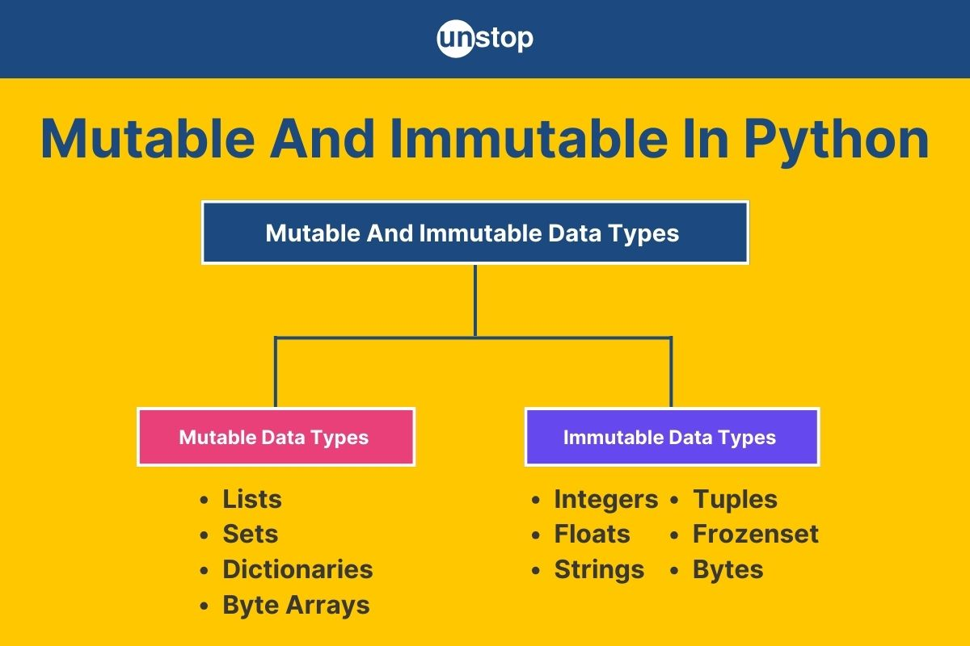
Lecture
SLIDE 4 / 14
Understanding Tuple Immutability
1
Tuples are immutable sequences that cannot be modified after creation
2
Immutability ensures data integrity when sharing objects across multiple functions
3
Attempting to modify a tuple element raises a TypeError exception immediately
4
Immutable objects are hashable and can serve as dictionary keys
5
The memory overhead for tuples is slightly lower than for lists
6
Tuples provide a safer alternative for storing configuration constants in code
7
Use tuples when the data collection should never change during runtime
Mutable & Immutable In Python: Key Differences, Types, & More
Chandigarh University
4 / 14
Notes:
Think of a tuple like a printed contract; once signed, you cannot change the terms. If you try to change a value in a tuple, Python stops you with a TypeError. This feature is crucial because it prevents accidental data corruption in your programs.

Slide 5
Lecture
SLIDE 5 / 14
Advanced Text Parsing Techniques
1
Use the split() method to divide strings into lists based on delimiters
2
Apply regular expressions for complex pattern matching within unstructured text
3
Strip whitespace using strip() before processing string data for accuracy
4
Parse CSV files by reading lines and splitting on comma characters
5
Handle parsing errors using try-except blocks to prevent program crashes
6
Convert parsed string numbers to integers or floats for numerical calculations
7
Combine split and strip methods to clean messy input data effectively
Chandigarh University
5 / 14
Notes:
Text parsing is the art of turning messy strings into structured data. For example, splitting a line like 'John,25,Engineer' gives us a list of individual values. We often combine this with strip() to remove unwanted spaces before converting the data types.

Slide 6
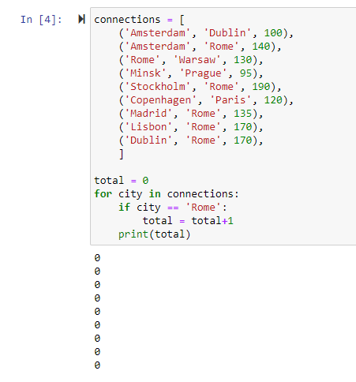
Worked Example
SLIDE 6 / 14
Parsing Student Data
INPUT STRING
'Alice,21,CS,95.5;Bob,22,ME,88.0'
STORE THE CLEANED DATA AS A TUPLE
('Alice', 21, 'CS', 95.5)
• Split by semicolon to separate individual student records into a list
• Iterate through the list and split each record by comma delimiter
• Convert the age string to an integer and grade to a float
• This process transforms raw text into a structured list of tuples
• The resulting data is ready for sorting or database insertion operations
Source: us1.discourse-cdn.com
Chandigarh University
6 / 14
Notes:
Let's look at a concrete example. We have a string with two students separated by a semicolon. We split this into two parts, then split each part by commas. Finally, we convert the age and grade to numbers and store them as tuples. This creates a clean, structured dataset.

Slide 7
Lecture
SLIDE 7 / 14
Tuple Comparison and Sorting
GOVERNING EQUATION
Comparison operators like , == work directly on tuple objects
1
Tuples are compared element-by-element from left to right sequentially
2
The first differing element determines the order of the two tuples
3
If elements match, Python moves to the next index for comparison
4
Sorting a list of tuples uses the first element as the primary key
5
Secondary keys are used automatically if the first elements are identical
6
This behavior allows for efficient sorting of complex multi-field records
Chandigarh University
7 / 14
Notes:
When comparing tuples, Python looks at the first item. If they are different, that decides the order. If they are the same, it moves to the second item. This is why sorting a list of student records works perfectly; it sorts by name first, then by ID if names match.

Slide 8
Common Pitfall
SLIDE 8 / 14
Modifying Tuples
1
Direct assignment to a tuple index causes a TypeError exception
2
You cannot append or remove items from an existing tuple object
3
Attempting to modify a tuple requires creating a new tuple entirely
4
Confusing lists with tuples leads to runtime errors in production code
5
Use tuple concatenation to create a modified version of the data
6
Always verify if data needs to be immutable before choosing a tuple
7
Check documentation to ensure you are not using a mutable sequence
Chandigarh University
8 / 14
Notes:
A common mistake is trying to change a tuple like a list. If you write 'my_tuple[0] = 5', the program crashes. You must create a new tuple with the updated value. Always remember that tuples are fixed once created.

Slide 9
Lecture
SLIDE 9 / 14
Tuple Unpacking and Swapping
GOVERNING EQUATION
The syntax 'a, b = (1, 2)' assigns 1 to a and 2 to b
1
Unpacking assigns tuple elements to multiple variables in one statement
2
Python supports simultaneous variable swapping without a temporary variable
3
Use unpacking to return multiple values from a function efficiently
4
The number of variables must match the number of tuple elements
5
Use the asterisk operator to capture remaining elements in a list
6
This feature simplifies code and improves readability significantly
Chandigarh University
9 / 14
Notes:
Unpacking is a powerful feature that simplifies code. Instead of assigning variables one by one, you can do it in a single line. For example, swapping two variables is as simple as 'a, b = b, a'. This makes your code cleaner and easier to read.

Slide 10
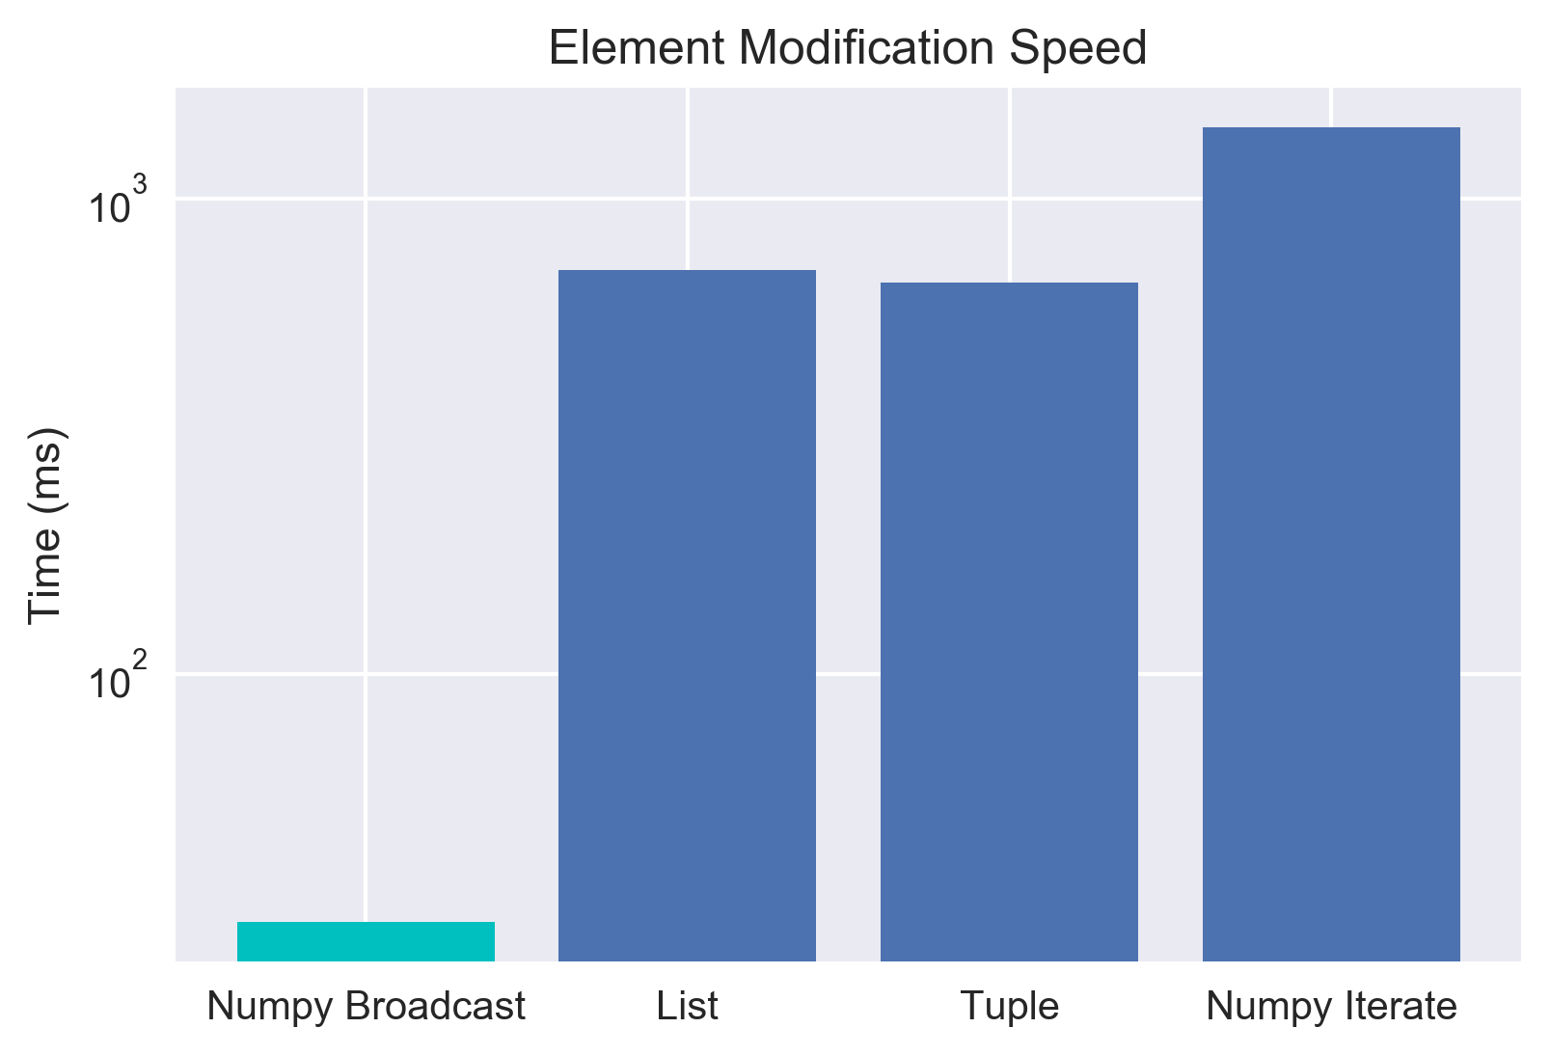
Performance
SLIDE 10 / 14
Tuples vs Lists
1
Tuples consume less memory than lists of the same size
2
Tuple creation is faster than list creation due to immutability
3
Iterating over tuples is slightly faster than iterating over lists
4
Tuples are preferred for read-only data in large-scale applications
5
Lists require extra memory for dynamic resizing capabilities
6
Use tuples for fixed datasets to optimize application performance
7
The speed difference is negligible for small datasets but significant for millions
Source: zwmiller.com
Chandigarh University
10 / 14
Notes:
Why choose tuples over lists? Tuples are more memory-efficient and faster to create. This is because Python doesn't need to reserve space for resizing. For large datasets where data doesn't change, tuples offer a performance advantage that scales well.

Slide 11
Lecture
SLIDE 11 / 14
Exception Handling in Parsing
1
Wrap parsing logic in try-except blocks to handle malformed input
2
Catch ValueError exceptions when string conversion fails for numbers
3
Catch IndexError exceptions when accessing non-existent list indices
4
Provide user-friendly error messages when data format is incorrect
5
Use the else clause to execute code only if no exceptions occur
6
Validate input data before attempting complex parsing operations
7
Robust error handling ensures the program continues running smoothly
Chandigarh University
11 / 14
Notes:
When parsing files, data is rarely perfect. You must handle errors gracefully. For instance, if a number is missing, a ValueError will occur. By using try-except blocks, you can catch these errors and log them without crashing the entire program.

Slide 12
Lecture
SLIDE 12 / 14
Real-World Application: Log File Analysis
1
Read server logs line by line to extract error timestamps
2
Parse log entries to identify specific error codes and severity levels
3
Store extracted data in tuples for efficient aggregation and counting
4
Filter logs to find critical errors occurring within a time window
5
Generate summary reports by counting occurrences of each error type
6
Use dictionaries to map error codes to human-readable descriptions
7
This approach automates system monitoring and alerting processes
Chandigarh University
12 / 14
Notes:
Consider analyzing server logs. You read each line, extract the timestamp and error code, and store them as tuples. You can then count how many × a specific error occurred. This automation helps engineers quickly identify and fix system issues.

Slide 13
Lecture
SLIDE 13 / 14
Key Takeaways
1
Tuples are immutable sequences that ensure data integrity and safety
2
Advanced parsing requires splitting strings and handling conversion errors
3
Tuple comparison works element-by-element for sorting complex records
4
Unpacking allows efficient assignment of multiple variables in one step
5
Tuples offer better memory efficiency and speed for read-only data
Chandigarh University
13 / 14
Notes:
To summarize, remember that tuples are immutable and safe for data integrity. You can parse text effectively by splitting and handling errors. Tuple comparison allows for complex sorting, and unpacking simplifies variable assignment. Finally, use tuples for better performance in read-only scenarios.

Slide 14
Lecture
SLIDE 14 / 14
References
PYTHON
A Practical Learning Approach, 1st Edition — T.S. Murugesh, Shriram K. Vasudevan, Sini Raj Pulari
• Learning Python, 6th Edition — Mark Lutz
• Starting Out with Python, Global Edition, 6th Edition — Tony Gaddis
• Introduction to Python Programming and Data Structures, 3rd Edition — Y. Daniel Liang
Chandigarh University
14 / 14
Notes:
These four books provide comprehensive coverage of Python programming and data structures. I recommend 'Learning Python' for deep dives and 'Starting Out with Python' for clear explanations. Please refer to these texts for further practice and advanced topics.

